Slide 1
NSSLA October 19, 2022

Slide 2
Word finding – beyond mnemonic cues
NSSLA October 19, 2022
Jan Schwanke, M.A., CCC-SLP
Notes:
Thank you for inviting me here tonight. There have been quite a few updates in the research into child word finding in the last few years, so if you heard me speak a few years ago, I hope there is something new for you tonight. I’ll warn you that some of the videos are the same. It’s hard to ask parents for their consent to show their kids on video, so I’ve continued to use the ones that are relevant.

Slide 3
Disclaimers
I am an independent contractor with Comprehensive Speech and Language Therapy, LLC, in Northfield.
I am an adjunct instructor in special education with National-Louis University in Wheeling .
Member of NSSLA, ISHA, and ASHA. CCC-SLP
I am receiving an honorarium for tonight’s presentation.
I have no nonfinancial disclosures to report.
Notes:
a couple of disclaimers

Slide 4
AgenAgendada for thiAgendas evening
Review of concepts from Word Finding Intervention Program
New research
Strategies to promote word finding in individual words
Strategies to promote word finding in conversational speech (discourse)
Ideas for carryover
Q&A
Please ask questions at any time during the presentation

Slide 5
AGenda for tonight Objectives
Objectives for tonight
After attending the presentation, participants will be able to:
Describe 5 different strategies that can be presented to children and adults experiencing word finding difficulties,
Identify children who can benefit from word finding intervention using an observation checklist.
List activities that will promote generalization of strategies into conversational speech.

Slide 6
Updates in word finding
Research needed!!
Notes:
There is a great need for additional research in word finding. Diane German has retired and it is a fascinating field that needs some fresh blood. I’ll present some new research tonight.

Slide 7
RALLI campaign (Great Britain)
Notes:
YouTube wouldn’t let me imbed this video into the presentation, so stay with me as I share the screen with this video. The RALLI campaign was an internet campaign in Great Britain entitled Raising Awareness of Language Learning Impairments. I don’t think the narrator will win an Oscar, but the videos of kids experiencing word finding problems are worth watching.

Slide 8
Identification
Test of Word Finding III or Test of Adolescent/Adult Word Finding
Test of Word Finding in Discourse
Word Finding Referral Checklist
Word Finding Observation Scales -- Parent, Teacher, Self
Language Samples
Receptive vs. Expressive vocabulary
How do parent, teachers, and children/adults perceive the child’s (or their own) communication?
Notes:
Let’s first talk about identifying kids with word finding problems. I typically start with Diane German’s Test of Word Finding – 3rd Edition or the Test of Adolescent/Adult Word Finding. But as we will discuss later, some clients have word finding difficulties in single words but not in conversation. Some exhibit word finding difficulties in conversation, but often do fine in single words. So we need to look at the types of disruptions our clients exhibit in their day-to-day communication. All of these tests and checklists can provide good information (read list). Bottom line, however, is how disrupted the child’s expressive language sounds to his listeners.

Slide 9
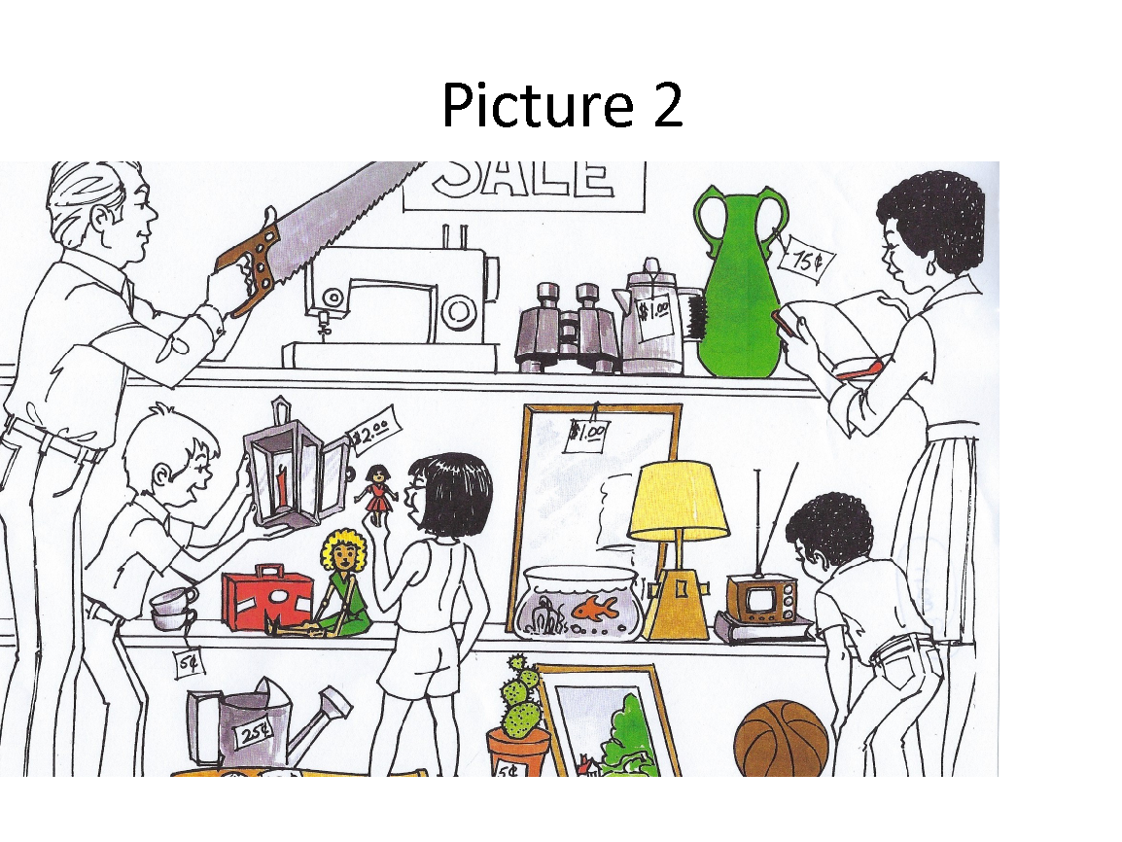
Word Finding in Discourse
Notes:
The TWF in Discourse manual states that you can substitute different pictures for the pictures provided by the test. Since the test was published in 2014, I think some of the pictures may need to be updated. I’m not sure the TV is even recognizable as a TV, and the binoculars might not be familiar in 2022. The red lunchbox might not be too familiar. I showed a little girl a picture of a “thermos” the other day, and she acted puzzled, then wondered if it was a water bottle. So if we’re going to look at retrieval of words, we need to be sure the receptive vocabulary is familiar.

Slide 10
Word Finding in Discourse sample
But um, yeah, I mean, it would be, there wouldn’t be this foliage and um everyone would have to wear a jacket and it would be cold
Um, Should I describe oth..any other pictures?
Um I think they’d be throwing like a snowball or they’d be playing like hockey if there’s an ice rink.
Or, Um , [unintelligible] They’d be indoors or something… doing wrestling?
[ describe sports outdoors]
Outdoors? Uh, Yeah, Hockey uh, but, other..I forgot what I said before… um, hockey and snowball fights
Yeah, um, also….( 7 seconds??)um, sledding, I don’t know, just sledding, yeah
They could be buying, like, I mean it depends on whose birthday I guess, but um, also they could be buying also like they could be buying supplies like par…like balloons and um (6 secs) or uh fun games to play
Like they could play like Hacky, uh Hacky.. uh what’s the sack game? Like cornhole or something, party games
Notes:
This is a good example of why you can't just compare receptive vocabulary vs. expressive vocabulary. This is my actual transcript from the Word Finding in Discourse from a very bright young man heading for the Univ of Illinois in computer science. Both his receptive vocabulary and even expressive were outstanding. He used words like foliage and lantern and named items accurately. But listening to him speak certainly gives you the feeling that he’s struggling to express himself.

Slide 11
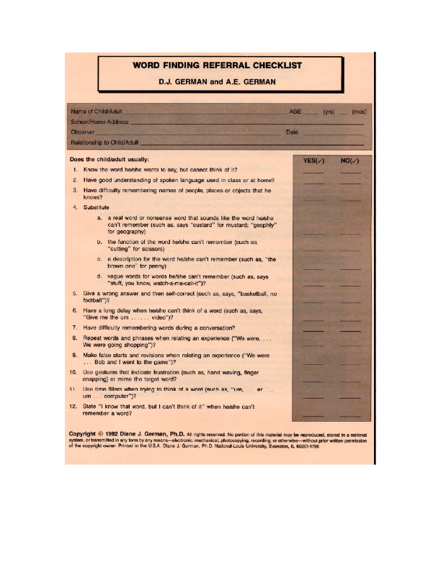
Word Finding Referral Checklist
Notes:
You are probably familiar with Diane German’s word finding referral checklist. It’s designed for teachers to provide information to SLPs . But I hoped to create something for parents and teachers that was more quantitative, so with Diane’s consent, I developed observation scales that used her checklist information.

Slide 12
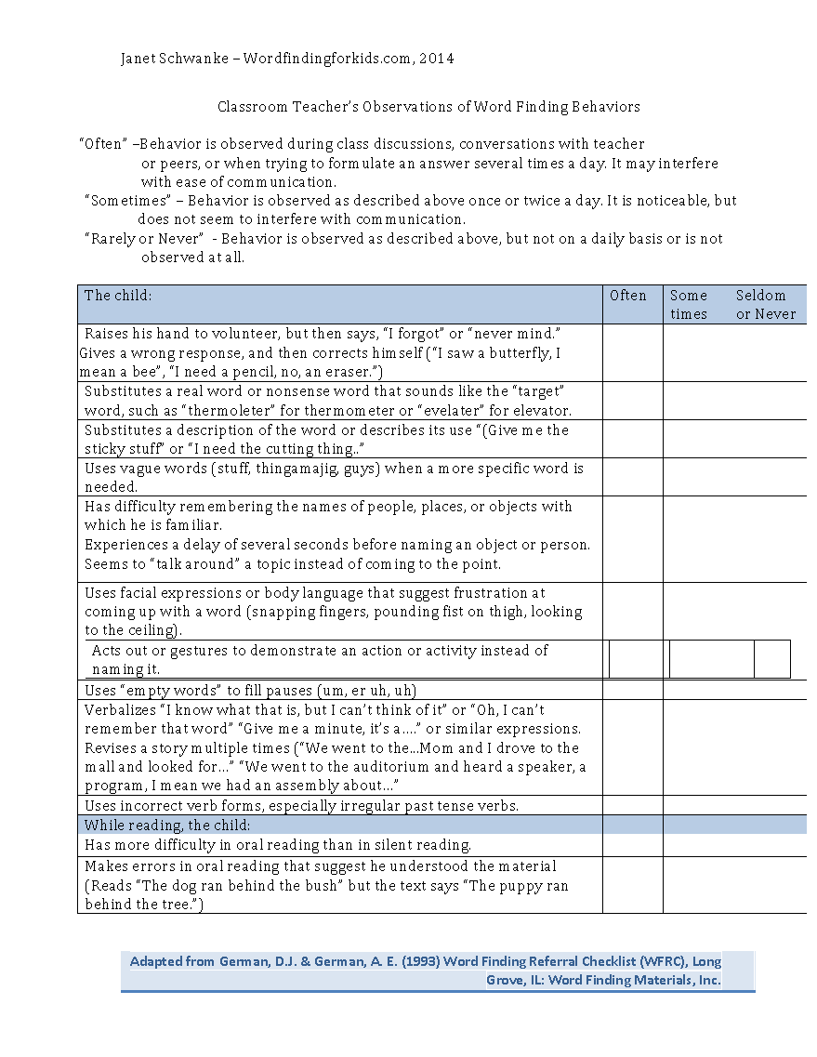
Word Finding Observation Scale - Teacher
Notes:
The teacher’s scale has basically the same items, with different examples that are more pertinent to the classroom.

Slide 13
Word Finding Observation Scale - Parent
Notes:
If you printed out the 3 observation scales that I emailed with my PowerPoint slides, please pull them out. I developed these observation scales for parents, teachers, and for the word finders themselves. I assigned 2 points to any behavior observed “often” (defined as behaviors that are observed several times a day and interfere with communication. I assigned 1 point to any behavior observed “sometimes” or once or twice a day. I then totaled the number …which I have no norms for. I had some grand idea about doing a research study and publishing norms. But I never did it. I still find that the scales are helpful, especially as a point of discussion with parents. Over time, you can measure if the word finding behaviors have decreased. [read through items]

Slide 14
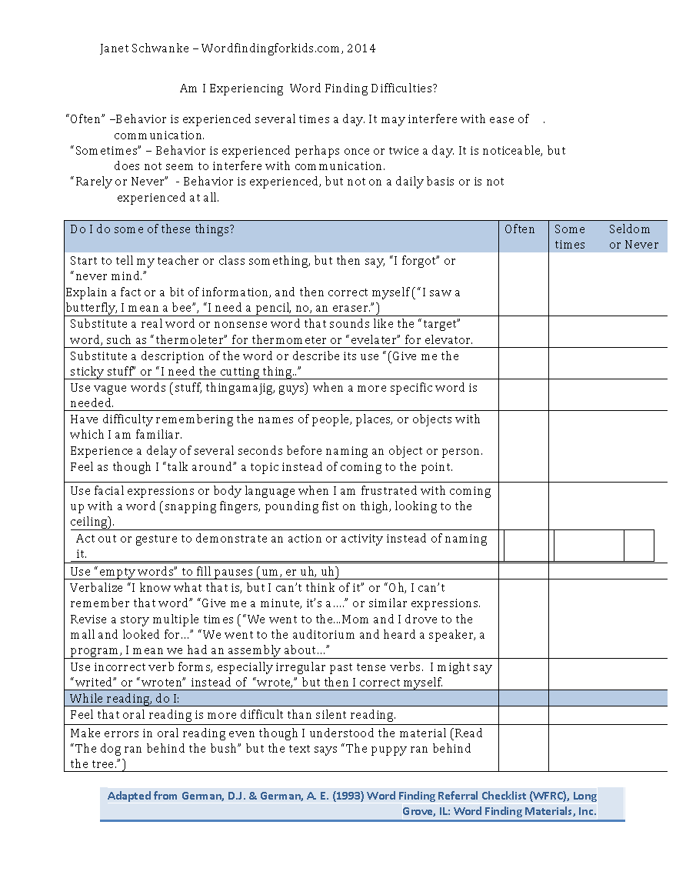
Word Finding Observation Scale - Individual
Notes:
The scale for individuals is really for older kids and adults. I’ve been able to use it with middle school kids to discuss the types of word finding challenges they experience.

Slide 15
Listeners’ perceptions
A study of young adults (Tingley, Kyte, Johnson, Beitchman 2003) compared frequency of conversational disruptions with performance on 3 single-word tasks. Rapid Automatic Naming was the only significant predictor of conversational disruptions (although the relationship was weak).
Some who did poorly on single-word tests had few conversational disruptions.
Some who did well on single-word tests had frequent conversational disruptions.
Unfortunately, gains made in intervention at the single-word level may not be observed in conversation.
The 3 tasks used:
3 single-word tasks: total time from the Rapid Automatized Naming task (RAN; M. B. Denckla & R. G. Rudel, 1976), standard score from the Brief Test of the Test of Adolescent/Adult Word Finding (TAWF; D. J. German, 1990), and total unique words from the Controlled Oral Word Association task (FAS; A. L. Benton & K. Hamsher, 1978).
Notes:
Perhaps more important than test scores or observation scales are what the listener perceives. In some respects, it’s like stuttering: the same number of disfluencies may be perceived as more or less disruptive depending on the type of disfluency the listener hears. This study from 2003 was particularly interesting. (read slide)

Slide 16
A starting point: AWARENESS
Recognizing WF difficulties in OTHERS may be easier than recognizing WF difficulties in ones’ own language.
Notes:
So using tests, observation scales, and listeners’ perceptions, we’ve decided that intervention would be helpful. So where do we start? Those of you who have heard me speak before know I am BIG on "awareness."

Slide 17
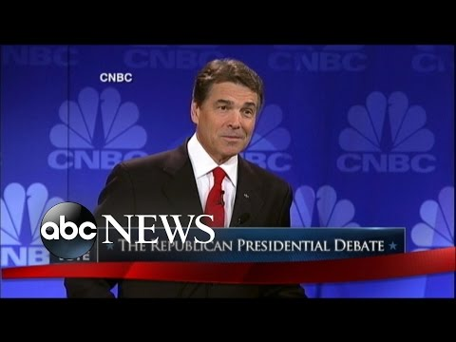
OOPS!
Notes:
This is old, but it’s a classic. When Rick Perry was running for president in 2011, he experienced a huge word finding block on during a nation-wide televised debate.

Slide 18
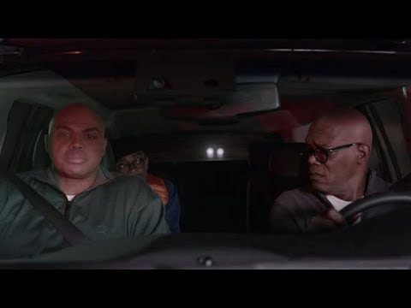
Charles Barkley for Capital One
Notes:
The kids get a kick out of Charles Barkley complaining that the word was just on the tip of his brain.

Slide 19
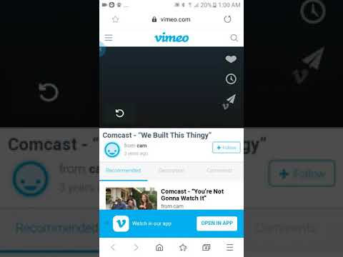
Xfinity – We Built This Thingie (20 secs)

Slide 20
Building a snowman
Notes:
I used kids from the drama club to act out dialogs and asked my word finders to identify the word finding difficulties they observed.

Slide 21
Spring break in SH….SHHChicago

Slide 22
Two primary determinants of ease of retrieval
Frequency of use
Recency of use
Notes:
[read slide first] We probably don’t need a word finding cue for COVID or vaccination. However, 3 years ago we might have struggled to retrieve those words.

Slide 23
Simulate a word finding difficulty
“No ‘R’ Activity”
Notes:
This is an activity I use with my graduate students taking an expressive language course. The need to spend 5 minutes in a conversation with another person without using any “R” sounds. Can you explain going to a a restaurant? Can you talk about an upcoming vacation? Take a couple of minutes and try to speak aloud, avoiding any words with ”r” sounds.
How did it feel? Stilted? Frustrating? Did you just want to quit speaking altogether?

Slide 24
Great overlap of LLD and word finding, anxiety, and attention
Word finding
anxiety
attention
Notes:
There’s a great overlap of word finding and language learning disabilities. But anxiety and attention are also hugely impactful. Speaking of anxiety…that frustration just made your word finding worse, didn’t it?

Slide 25
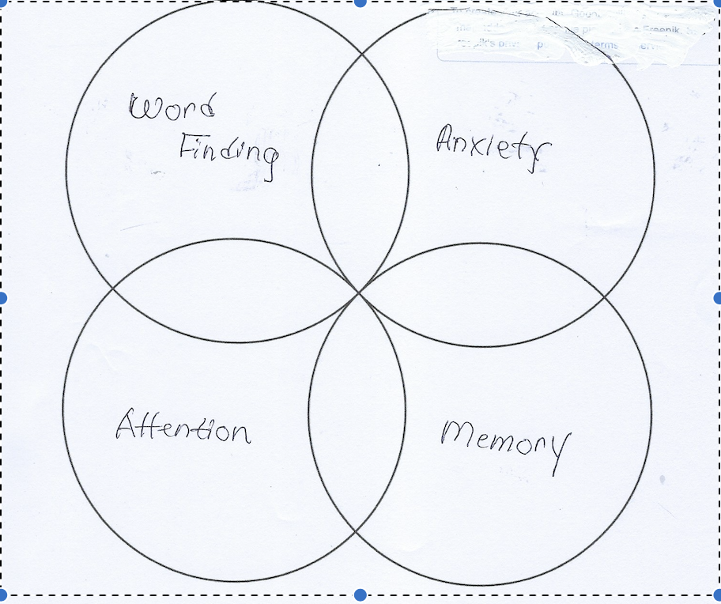
How about memory?
Notes:
Memory has a huge impact on retrieval. In fact, as I was doing research into memory, I came across many of the same strategies that I use for word finding.

Slide 26
Research into memory
Images are easier to remember than words.
“Memory Hooks”
Notes:
The memory research tells us that images are easier to remember than words, and that “memory hooks” can be a shortcut to remembering more complex things.

Slide 27
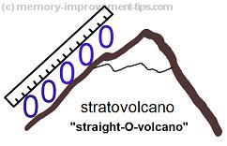
From the memory literature
My stratovolcano visualization
Notes:
This looks strangely like our word finding cues, doesn’t it? We’ll talk more about these mnemonic cues in a bit after we talk about some other strategies.

Slide 28
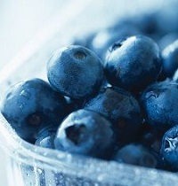
Blue bear works as a memory hook for "blueberries"

Slide 29
Differential Diagnosis - 3 types
"Type 1" word finders fit the error pattern that Dr. German calls "slip of the tongue." Error pattern 1 are kids who make semantic, lemma-related errors. What is a "lemma-related error"? This is a disruption in accessing the semantic features of a word. How do we recognize these kids? These are the kids who are fast but inaccurate. They make a lot of revisions and substitutions of words that are in the same category or somehow related to the target word. They may say "basketball, I mean baseball," or "I want a hammer, I mean a nail." We typically do not see secondary characteristics in these children (eyes to the corner of the room, fist to the thigh, palm hitting one's forehead in frustration).
The errors we find with Type 1 more often occur on frequently occurring words. They are more typically familiar and shorter words and occur in "dense neighborhoods." Dense neighborhoods are groups of words that are phonologically similar (red, bed, head or head, hid, had). These kids sometimes make mistakes retrieving compound words. When they read aloud, they make errors in familiar words. So when they see "dog," they may say "puppy." Obviously, they read the word correctly if they substituted "puppy" for "dog." It was an error in retrieval, not a reading error.
Notes:
Diane German labels 3 different types of word finders. [read]

Slide 30
Type I, Slip of the tongue, continued
Type 1 word finders might regularize irregular verbs: he sitted, she eated. In naming categories, they might name examplars within the category instead of giving the category name (instead of "vegetable," he might name "broccoli"). They realize they were inaccurate, and correct themselves ("broccoli, I mean vegetable." ). The reason for this is that the words are competing within the child's lexical system. He names a word quickly and immediately recognizes his error.
These students benefit from slowing down. Some of the strategies I use for children who stutter are effective with these rapid, inaccurate namers: model a calm, steady pace and allow a slight pause before responding.

Slide 31
Type II – Tip of the Tongue
Type 2 Errors are "tip of the tongue" errors. These are the s-l-o-w retrievers. These word finders experience a lot of delays and time fillers "...uh, um, it's a.....uh, you know....". They may say things like "It starts with a t" or "Wait a minute, I know it". They may not provide an answer at all. They may use gestures that tell you they know the word for which they are searching (e.g., pounding to indicate "hammer") or secondary characteristics of frustration such as hitting their fist on their thigh, snapping their fingers, or looking up to the ceiling. These "tip of the tongue" errors are perhaps the most common word finding errors.

Slide 32
Type II, continued
Children who experience Type 2 errors are more likely to err on less common words. The words may be longer in length than Type 1 errors and may come from less dense phonological neighborhoods. In other words, there aren't a lot of words that sound similar to them. In oral reading, their errors reflect the same patterns: lower frequency words with less common phonological patterns. Errors on irregular past tense verbs can be a red flag for Type 2 learners. Another potential difficulty is labeling a category.
Phonemic cues are highly effective for Type 2 word finders. They often retrieve the word when their listener provides the beginning consonant+vowel or first syllable of the word for which they are searching.

Slide 33
Type III – Twist of the Tongue
These are the students who benefit most from segmenting word into syllables and associating a phonemic cue with the "evasive" syllable. Try to associate an easily-retrieved, simple word with the part of the word on which the student struggles. For example, to reinforce "territory," I use "tear it/tore it" and have the students tear a piece of paper as they say, "tear it," then "tore it." For "ligament" we use "lick a mint." First break the word into syllables and reinforce saying each syllable. Then add the cue, followed by repeating the entire word and using it in a sentence. Dr. German's procedure from the Word Finding Intervention Program - 2 is very specific.

Slide 34
Intervention
Dr. Diane German recommends a 3-pronged approach:
(1) retrieval strategy instruction
(2) self-advocacy instruction
(3) accommodations
Notes:
We’ll talk about strategies, self-advocacy and accommodations. BUT FIRST…

Slide 35
But WAIT A MINUTE!!!
Tailor the intervention to the type of learner. New research suggests that the most effective intervention depends on a child’s own language profile. Children who had difficulty with either semantic or phonological abilities gained the most from the intervention that matched their area of weakness.
Best, Hughes, Masterson, Thomas, Howard, Kapikian, and Shobbrook (2021) used phonological and semantic word webs to assess the effects of intervention.
Semantic word webs: What does it look like? What do you do with it?
Phonological word webs: What does it rhyme with? What sound does it start with?
Among treated words semantic intervention resulted in a gain of almost twice as many items as the phonological intervention.
However, looking more closely at individual children showed that the children with semantic weakness gained most from semantic word webs. The children with phonological weakness gained the most from phonological word webs.

Slide 36
Best, et al, continued
“The approach involves encouraging active participation so that children produce or choose features of words and in later sessions reflect on what helps them retrieve words.”
In this study, children did not generalize their skills to words that had not been included in the treatment. What are the implications of this?
My own opinion – it’s especially important to present words that are meaningful and useful for each individual child and we need to teach strategies so they can apply their knowledge to new words.
Notes:
[read slide]

Slide 37
Multi-sensory intervention
The literature from MEMORY and psycholinguistics should inform us. The more senses we can include in our therapy, the better!
Auditory, visual, touch, smell… also think of the power of music
Notes:
To this day, I still sing ”30 days hath September” silently to myself to remember which months have 30 days. I think I learned that song in 1st grade. And most kids still sing the ABC song to themselves to remember that alphabet. I also use a little song with the Expanding Expression Tool to remember the significance of each color bead. If you’re not familiar with the EET we’ll talk about that when we talk more about “describing’ as a strategy.

Slide 38
Active Interactive learning
“Our results evidence the crucial role of interactive learning in contrast with passive learning procedures widely used in the literature. The key role of personal experience, or action or emotion in association with the task, are consistent with the Pavlovian learning paradigm. However, this reinforcement method is still underestimated in linguistic methodology.”
(Medicalxpress/com/news 2020 Author: Razorenova
Notes:
Interactive learning can be very powerful. A researcher named Razorenova stressed this in her study when she wrote “

Slide 39
Strategies
“a plan of action or policy designed to achieve a major or overall aim”
What strategies have they learned? How can word finding strategies help them in class? On tests? Talking with their friends and family?
Notes:
So what is a “strategy”?? First we need to be sure the child understands what a strategy is. They have learned reading strategies, comprehension strategies, basketball strategies…I remember asking one of my word finding kids what strategy worked best for him and he said, “SQ3R”. No, that’s reading strategy, not a word finding strategy. So we need to be sure our word finders know what they’re working on.

Slide 40
Strategies…
STRATEGY
“a plan of action or policy designed to achieve a major or overall aim.”
“a plan, method, or series of maneuvers or stratagems for obtaining a specific goal or result”
master plan
grand design
game plan
plan of action
plan
policy
We can have strategies for word finding, remembering, winning a game, or even cleaning our room. What’s the plan? How can we accomplish what we want to?
Notes:
I ask the kids what strategies their favorite teams use to win a game. That leads into taking about strategies to retrieve words. How can you “find it in your brain”?

Slide 41
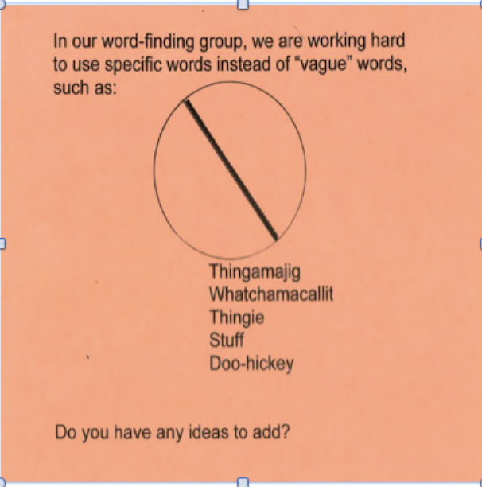
Use specific words
Notes:
The kids who use “thingie” “stuff” and “guy” in every other sentence need to learn to use specific words.

Slide 42
Use specific words
I need to buy a thingie.
Where did you put my school stuff?
I saw a guy in the car place.
He found a thingamajig in his backpack.
Notes:
We talk about how these vague words don’t tell our listeners what they need to know.

Slide 43
Reflective Pause CHILL!
“Reflec
Think about working with disfluency – Take your time
responding and model a calm, deliberate rate of speech.
This is especially effective with what Dr. German calls ”Type 1” word finders.

Slide 44
Notes:
Reflective Pause -- CHILL! Must wait 5 seconds before responding.
Here the girls are playing "Blurt," with a change in rules.

Slide 45
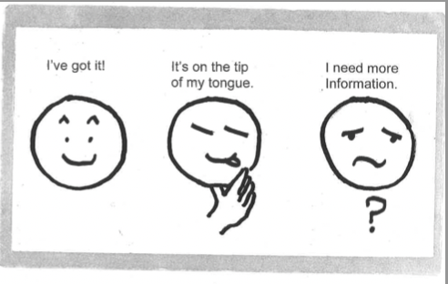

Slide 46
Visualizing
Make a picture in your mind.
Close your eyes and see a video in your head.
Visualizing and Verbalizing (more on that in January)
Expanding Expression Tool (EET) – also good for DESCRIBING
Notes:
I return to visualizing again and again. For a story -- What does the character look like? What is he or she doing? Tell me about the setting. If it’s an object , I often use the EET – Expanding Expression Tool. – what color is it? What shape is it? What parts does it have? Green group, blue do, what does it look like, what is it made of? Pink parts, white where? What else do I know? Sing song!

Slide 47
Word Associations and Categories
Semantics is all about putting words into categories and learning about the connections among words.
C Colors, shapes, transportation,
Pets, soccer words, birthday party words, current events, curriculum words
More learners gained from semantic webs than from phonological webs in Best’s study, but remember that it depended on the type of weakness a child exhibits (Best et al, 2020)
Notes:
I work a LOT on word associations and categories. When you think about it,kids learn by putting information into categories. The whole area of semantics talks about classifying information. I explain the “categories” are a special kind of word associations – you can name word in a category (such as pets) – dogs, cats, guinea pigs, gerbil, goldfish) but you can also name words that GO with a particular category (leash, collar, dog food, aquarium, vet). It all boils down to reinforcing the connections among different words.

Slide 48
Word Associations and Categories
Analogies, analogies, analogies - have the student EXPLAIN why the answer is correct .
“Pickles to Penguins” Younger kids: Rocky’s Mountain
“Apples to Apples” compare and contrast
Tri-Bond Junior
Notes:
A resource I like for analogies is the website “English for Everyone.” It’s full of good ideas. I also like “Analogy Adventure.” by…Linda Schwartz and Beverly Armstrong (available through Amazon)..

Slide 49
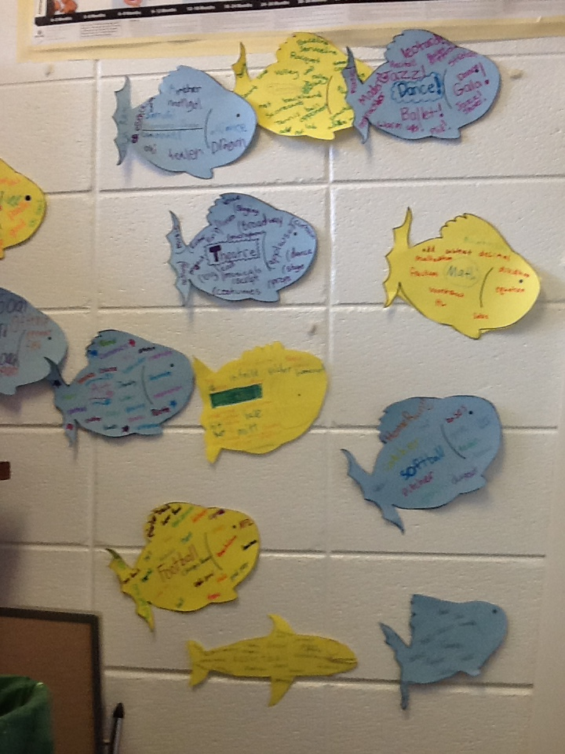
Word Associations
Notes:
I used these fish for word associations and borrowed a fish net from the PE department to display on my wall.

Slide 50
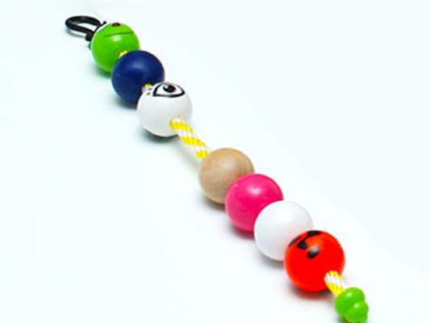
Describing Things
“Salient Characteristics”
Small category and 2-3 important details
Expanding Expression Tool
Notes:
The Expanding Expression Tool is effective for teaching kids to describe objects in more detail. But for word finding, I like to use it in a different way. We talk about naming the “group,” or category, then name the characteristics that are uniqiue to that object. We know these are “salient characteristics.” And I even teach that term to the older kids. For the younger ones, I ask them to name what is special about that item. For example, if we are thinking of the word “chair,” we don’t need to say it’s brown or it’s made out of wood. Instead we want to say it’s a piece of furniture that one person sits on. For a camel, we could say it’s a desert animal with a hump..or two humps.

Slide 51
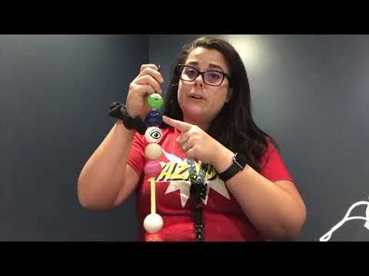
Expanding Expression song

Slide 52
Describing Things
Hedbanz - Change the rules!
Blindfold
Writing Prompt pictures

Slide 53
Describing things
How about working on emotions?
Describe the feeling and range of emotions – “sad” or blue, down in the dumps, weepy, depressed, devastated, grumpy
“Happy? “ Or elated, on cloud 9, pleased, cheerful, content, joyful, ecstatic
Many social language activities can be used with word finders.
Notes:
But not everything can be pictured! I put “feelings” vocabulary words on post-it notes and have the kids arrange them in order of intensity. This is where I try to be alert for the kids who don’t understand idioms.

Slide 54
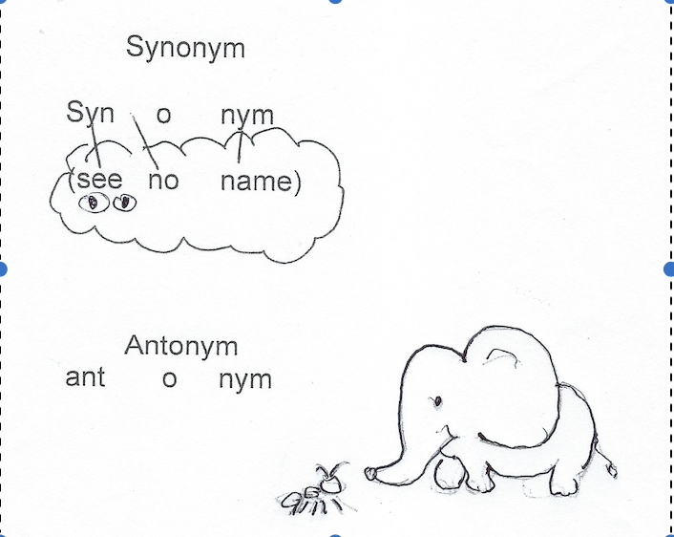
Synonyms and Antonyms
Notes:
To help the kids remember which concept is synonyms and which is antonyms , I drew this little visual . Synonym is “see no name” and Antonym is a contrast between the big elephant and the little ANT.

Slide 55
Beginning Sounds
Provide the beginning phoneme or syllable. Let the child “fill in the blank” and finish the word. This is more effective that providing the entire word for him. It reinforces those synapses that connect words.
“It starts with /ka/ NOT “It starts with a “C”.
Notes:
I have mixed emotions about this strategy. It seems to really help some people and not others. I suppose it depends on what kind of learner you are. We know we can “jump start” a word for a child by providing a phonemic cue. If they’re stuck on “Canteloupe,” we can help them out by saying “can…” . So if a child can learn to mentally go through the alphabet and think of beginning SOUNDS (not beginning letters), he can sometimes cue himself in by thinking of the beginning sound.

Slide 56
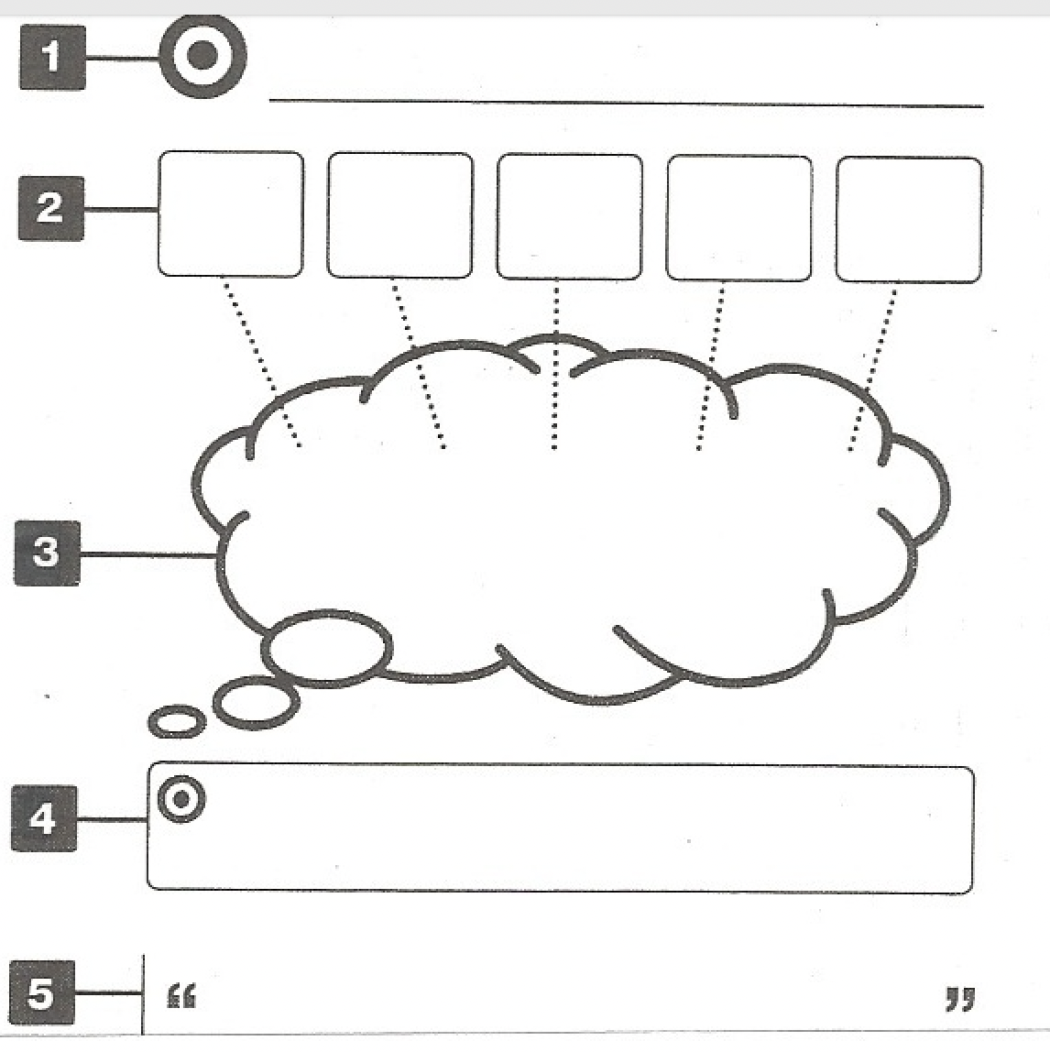
Mnemonic Cues
Notes:
This is the diagram from Diane German’s Word Finding Intervention Program. I call it the “small words” strategy or “using an easy word to remember a hard word.” Dr. German has a very specific procedure for reinforcing what she labels “evasive syllables” . First you break the word down into syllables. Tap them out, clap them out, stamp your feet, head/shoulders/knees toes, …Whatever you can do to make the syllables distinct. Then associate an easily-retrieved word with the difficult syllables. Encourage the child to “think the cue” but “say the word.” I think it’s very important to use pictures and as many modalities as possible. Examples: Pulaski Day, Polar Vortex. I tweaked her “memory cloud” idea to add pictures.

Slide 57
cauldron

Slide 58
cornucopia

Slide 59
Appalachian Mountains
Notes:
I brought cinnamon to therapy and had the kids smell warm apples and cinnamon. The more senses, the better.

Slide 60
Hibernate
Notes:
When we practice HIBERNATE, we crawl under the table and “HIDE….” “BRRR” it’s cold!

Slide 61
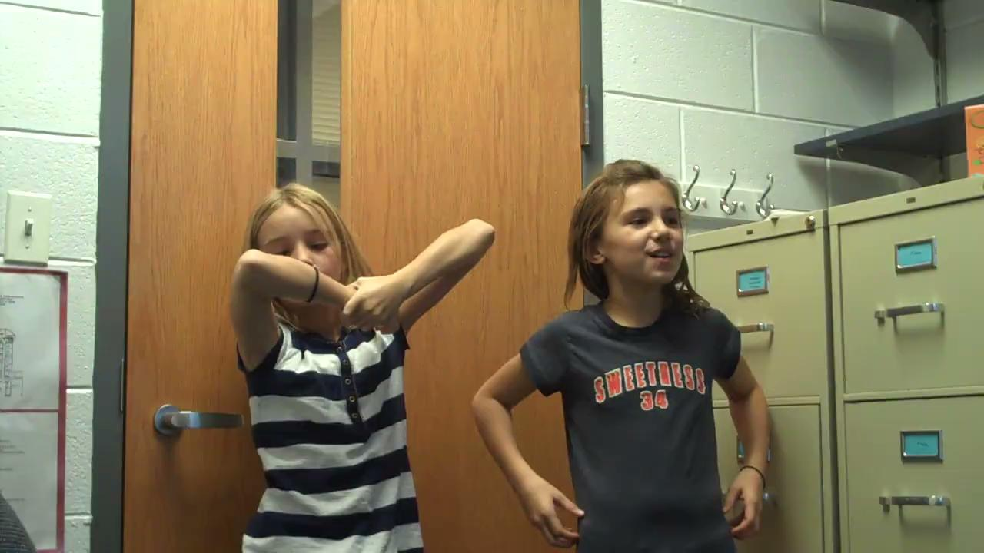
Probiscis, habitat and hibernate

Slide 62
Polar Vortex
Notes:
My favorite story about mnemonic cues is when I taught the kids the term “polar vortex” I had Kids climb on my table – polar bear at north pole reaching down for Texas. In the middle of this, the superintendent came to my door and saw little boys standing on my table. So I had them teach Dr. Lemon how they were learning word finding cues!

Slide 63
North Korea’s capital – (2018 Olympics) back in the news
Notes:
Pee on chain

Slide 64
Cues for shapes
Notes:
Cues aren’t only for difficult words: The cues can even be used for basic concepts: the triangle has 3 sides, like the tricycle’s 3 wheels, the rectangle looks like the wreck, and the square is cued by “square hair.”

Slide 65
Did I forget something?
Automatic associations
Closure tasks (“fill in the blank”)

Slide 66
Choosing Words
Select words for each child’s individual needs.
Words from the curriculum
Words from current events and holidays
Words from afterschool activities
Words from favorite sports
Notes:
Unfortunately improvement in word finding has NOT been found to generalize to untreated words. SO it’s particularly important to select our words for intervention carefully. Try to stay on top of the curriculum and present words BEFORE they are needed in the classroom. Remember that cultural referents change quickly. Example: “Swipe” used to mean “steal,” now it means to use your credit card. EXAMPLE

Slide 67
Words from curriculum
Notes:
Hatshepsut – an early female Egyptian pharoah. Proboscis, habitat and hibernate are part of the 2nd (?) grade curriculum,

Slide 68
Repeat, repeat, repeat
Make it stick! Anchor the words in your brain.
Word Finding 5
a “brain tattoo”

Slide 69
Mnemonics to remember strategies
Have child choose 2-3 “go to” strategies for when they’re “stuck”
Visualizing and word associations most helpful for most kids.
Notes:
I used to spend quite a bit of time encouraging the kids to develop their own mnemonic to remember all the strategies. But I’ve found that they typically find 2 or 3 that are most helpful

Slide 70
Silly Sally

Slide 71
Dumb Vegetables

Slide 72
Carryover
Anticipate vocabulary needed for a given situation
Phone calls, plans with friends, upcoming events
Role play
Ice breakers/conversation starters (Rockbrook Camp)
Invite friends to therapy

Slide 73
Carryover
“In clinical practice, SLPs will also routinely aim to ensure changes in children’s ability to retrieve single words in isolation are carried over to their use in discourse. The optimum ways of achieving this remain to be determined. Furthermore the most effective interventions will be encouraging children to develop and extend their own word-retrieval strategies according to what is most useful individually.”
(emphasis my own)
Best, Hughes, Masterson, Thomas, Howard, Kapikian, and Shobbrook, 2020
Notes:
So carryover is important, but best practices remain to be determined. How frustrating! At this point, I think it’s very important to have the child reflect on what works for him or her throughout intervention. As I introduce each strategy, I assign “homework” to practice that strategy during the week and see if it is helpful for them.

Slide 74
Going to a movie with Dad
Call____Dad______________on the phone. Please complete this by Wednesday, March 16.
Topic: Marvel movies
Greeting (Introduction): Hi, Dad, Jan is making me do this weird conversation.
Main conversation:
2-3 Marvel movies you like
Characters -- villains and heroes
Special effects
Plot - what did the villains and heroes do?
Upcoming movie
Sign-off (conclusion):
Thanks for talking to me. I’m looking forward to seeing the next movie.

Slide 75
Upcoming plans with friend
Please ask Eric to say these words aloud before beginning his project for next week. The two main things that affect word retrieval are (1) frequency of use and (2) recency of use. In other words, if he has used these words frequently and recently, they’ll be easier to “find” in his memory.
I have asked Eric to choose either Fortnite or movies to have a conversation with his friend Asher. I think he has chosen Fortnite, but either is fine. I’d like him to observe whether or not it is easier to have a conversation when the words are fresh in his mind.
Fortnite:
Tilted Towers unnamed locations (perhaps think of some)
Team microphone mini map
Skin special skills or powers styles
Costume hood mask
Battle Royal encounter weapon
Inventory for weapons bosses henchmen
Notes:
Words specific to “Uncharted”
Nathan Drake treasure hunt keys
Map treasure ship
Auction steal airplane
Colombia church hidden basement
Underground mission urns
Explode India betray
Unconscious

Slide 76
Movie words:
Cool script characters
Actors setting plot
Action stunts superhero
Villain
Words specific to “Uncharted”
Nathan Drake treasure hunt keys
Map treasure ship
Auction steal airplane
Colombia church hidden basement
Underground mission urns
Explode India betray
Unconscious
Notes:
At first, Eric had no words to describe a movie except “fun” and “cool.” But after we practiced a hypothetical conversation and discussed the topics he could talk about, he came up with all these words.

Slide 77
Family vacation to San Diego
Anticipating spring break vocab –
Vacation security TSA luggage
Baggage flight flight attendant
Carry-on take off/landing hotel lobby
Homework: choose one animal from San Diego Safari Park; list 10 words you may need to use - Matschie’s Tree Kangaroo!!

Slide 78
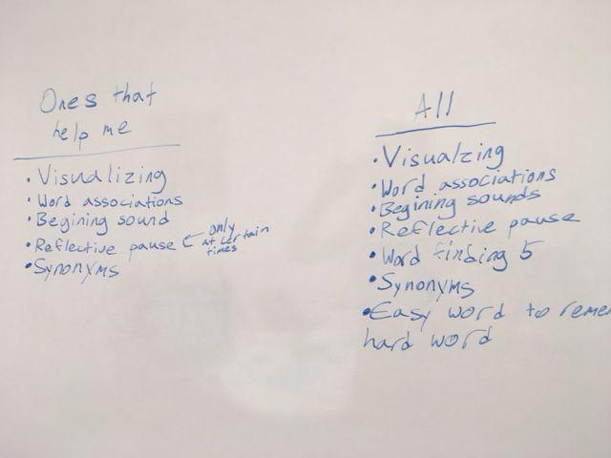
Review strategies often

Slide 79
Progress monitoring
As recommended by Dr. Diane German. She does NOT recommend using the TWF for pre- and post-testing.
Single words treated: Create a baseline of words that need treatment. (vocab from class, observed WF errors or self-report). Treat those words with same-sound cues, mnemonic cues, and repetition. After treatment, compare the accuracy rate of those same words. Are they named quickly and accurately?
Strategy usage: Create a rubric focused on independent usage of the strategies you have taught. “Not observable, “ “observable with assistance, “ “inconsistent, “ and “independent.” Rate the child’s application of the taught strategies.
Put the two progress monitoring approaches together. Your goal is that the learner is able to improve his/her accuracy in retrieving the vocabulary you have treated with retrieval strategies and that the learner is showing growing independence in his/her application of strategies.
Perhaps listeners’ and speakers’ perceptions of their own word finding abilities is the best measure of progress.
Notes:
I asked Diane German how she suggested monitoring progress. She does NOT recommend using the TWF to measure progress in intervention unless you have taught the words he/she missed on the TWF. [read slide] I have difficulty finding the right words to use for pre- and post-testing. I have asked parents and teachers to fill out the observation scales when I feel the kids are reaching their word finding goals. To me, that is a helpful measure of the progress they have made.

Slide 80
Self-
advocacy
Participate in IEP meetings (September-October 2022 ASHA Leader).
Start out with SLP accompanying child with teacher to discuss word finding difficulty and helpful accommodations.
Notes:
We’ve talked a lot about intervention strategies. How about self-advocacy?

Slide 81
Accommodations- Be sure learning is assessed with recognition tasks, not recall.
1. Preferential Seating: Confirm that Joey is seated so he can clearly see and hear his teachers and any teaching materials.
2. Provide a context for learning. Joey will benefit from having an overview of how his learning fits into the “big picture.”
3. Provide time for Joey to organize his thoughts before expecting an oral response. When possible, provide him with questions ahead of time.
4. Assess Joey’s reading progress with silent reading tasks instead of oral reading tasks. Because of his retrieval difficulties, he may understand more than is apparent.

Slide 82
Accommodations, cont’d.
5. Assess learning with recognition tasks instead of recall. Use multiple choice, word banks, T/F, and matching. When essay tests are used, provide Joey with a word bank of important words.
6. Allow Joey to use a written outline or scaffolding for oral presentations.
7. Use graphic organizers, visual supports, and multi-sensory presentations.
8. Check regularly for understanding of directions.
9. Allow extended time for all classroom and standardized assessments ( 1 ½ times).

Slide 83
3-pronged approach -- Wrapping it up
Strategies
Self-advocacy
Accommodations

Slide 84
Questions??

Slide 85
Resources

